Slide 1
STIHL AI Teach In: Prompt Engineering Workshop
A Use Case Based Approach
21 January 2025, Waiblingen

Slide 2

What We’ll Cover
Introduction
Workshop Overview
Use Case Based Learning
Microsoft Copilot 365
Embedding AI in Employee Workflows
Takeaways

Slide 3


Who Am I
Neil Sinclair, Senior Data Scientist, diconium Berlin
Deloitte strategy consultant turned data scientist
Projects: retail, insurance, and numerous GenAI projects

Slide 4
Overview of the Workshop
Who the Workshop Was Designed For
A big part of your role is making decisions
You want something that can help you make better decisions quicker
You want to reduce tasks that take up a lot of time and have little value so you can focus where you make the biggest impact

Slide 5
Overview of the Workshop
Who the Workshop Was Designed For
Our Approach
A big part of your role is making decisions
You want something that can help you make better decisions quicker
You want to reduce tasks that take up a lot of time and have little value so you can focus where you make the biggest impact
We will focus on use-cases to help you be more efficient
We will learn techniques only as they support the use-cases
This is a hands-on session – a lot of the time you’ll be working

Slide 6

Overview of the Workshop
Who the Workshop Was Designed For
Our Approach
The Expert
A big part of your role is making decisions
You want something that can help you make better decisions quicker
You want to reduce tasks that take up a lot of time and have little value so you can focus where you make the biggest impact
We will focus on use-cases to help you be more efficient
We will learn techniques only as they support the use-cases
This is a hands-on session – a lot of the time you’ll be working

Slide 7
Overview of the Workshop
Who the Workshop Was Designed For
Our Approach
The Expert
A big part of your role is making decisions
You want something that can help you make better decisions quicker
You want to reduce tasks that take up a lot of time and have little value so you can focus where you make the biggest impact
We will focus on use-cases to help you be more efficient
We will learn techniques only as they support the use-cases
This is a hands-on session – a lot of the time you’ll be working
The Executive Assistant

Slide 8
Overview of the Workshop
Who the Workshop Was Designed For
Our Approach
The Expert
A big part of your role is making decisions
You want something that can help you make better decisions quicker
You want to reduce tasks that take up a lot of time and have little value so you can focus where you make the biggest impact
We will focus on use-cases to help you be more efficient
We will learn techniques only as they support the use-cases
This is a hands-on session – a lot of the time you’ll be working
The Executive Assistant
The Researcher

Slide 9
Capabilities and Drawbacks
What Language Models Excel At
Generating text
Writing documents or code
Summarising text
Research
Reasoning (Limited)
Data processing (e.g. classification)
Planning and ideation with or without data
Information retrieval*
Semantic (meaning-based) search
*This is not specific to recent LLMs, but has been popularised recently

Slide 10
Capabilities and Drawbacks
What Language Models Excel At
What We Need to Watch Out For
Generating text
Writing documents or code
Summarising text
Research
Reasoning (Limited)
Data processing (e.g. classification)
Planning and ideation with or without data
Information retrieval*
Semantic (meaning-based) search
Language models give convincing answers – even when they aren’t real
This is called hallucination
Language models are tools, not replacements for people
Limited to knowledge in its training data which may not be relevant or true any more
Responses are not always the same – even for the same input
*This is not specific to recent LLMs, but has been popularised recently

Slide 11
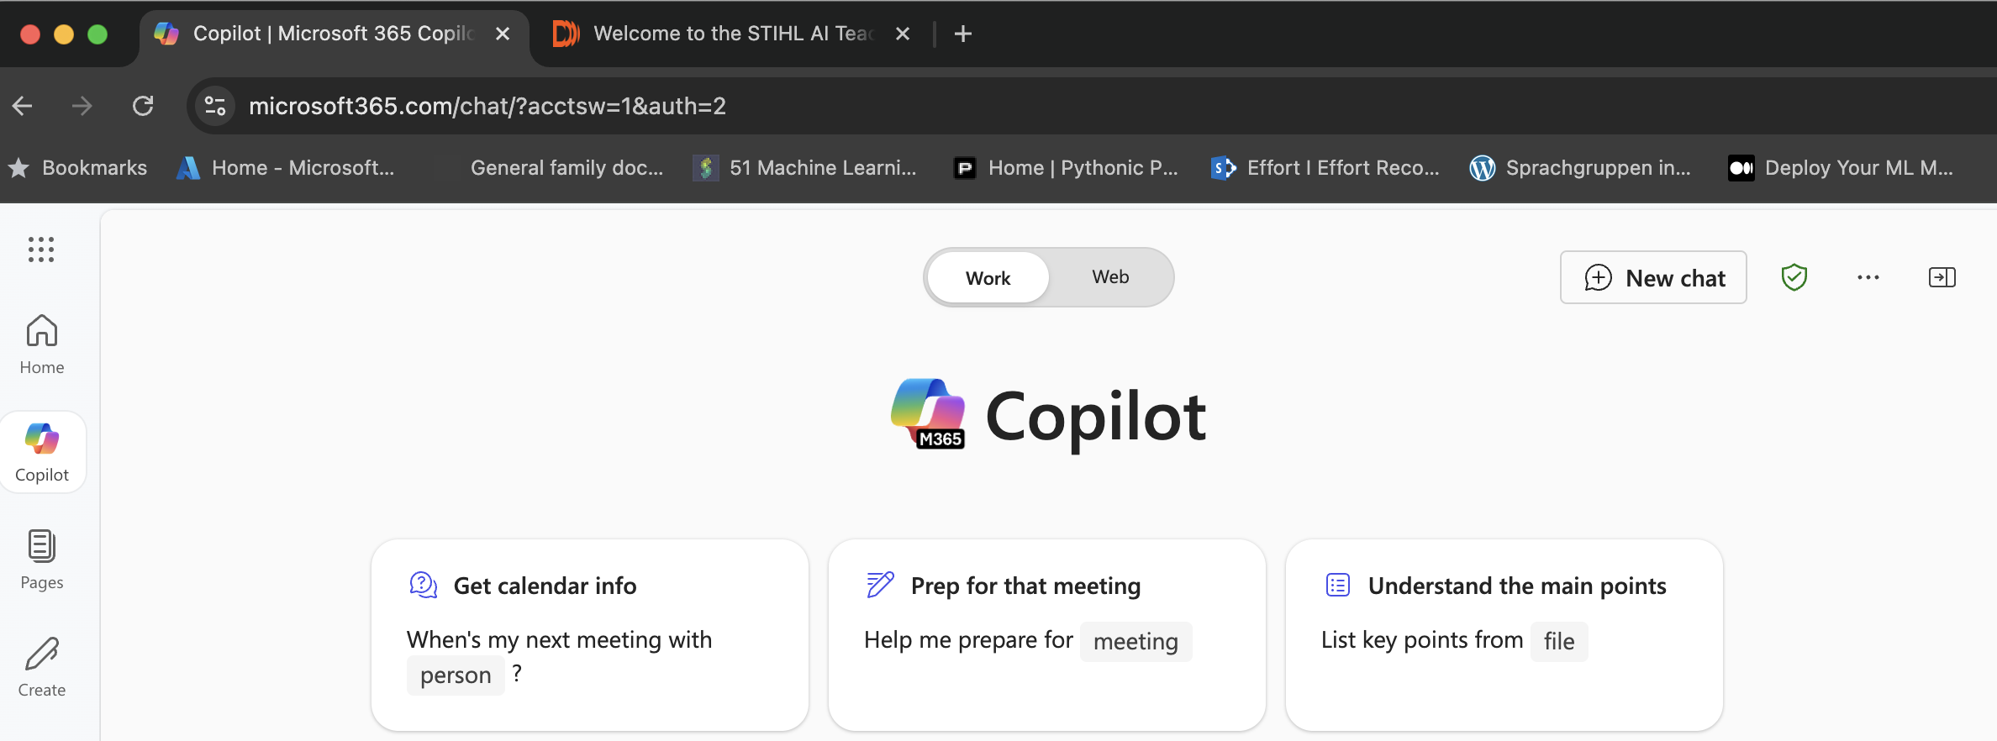
Overview of the Browser
Copilot 365
Content and Instructions webpage

Slide 12
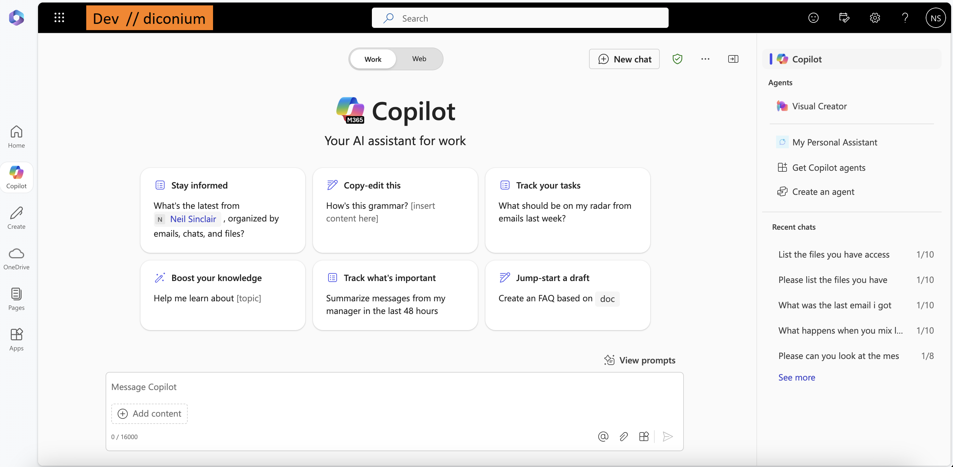
Overview of the MS365 Copilot
Toggle between ”Work” and “Web”
Start a new chat
Previous chats
Saved prompts
User message window
Attach a file
Attach a file

Slide 13
The Expert
Adding an expert to your team

Slide 14

Starting with the Basics: The Expert
Let’s get started!
Go to your browser.

Slide 15
Key Takeaways
The instruction message defines the character of the bot
Add information about your company or department to get more custom results
More detail is better
The process is experimental – create, test and iterate
You can save your best prompts for later, enabling you to store useful bots

Slide 16
The Executive Assistant
A personal executive assistant so you can focus on what matters

Slide 17

The Executive Assistant
Like a great executive assistant, your personal bot can take over some of the boring work you need to do. It can:
translate something quickly
draft the perfect email in seconds
create a quick summary of the main points in a document

Slide 18
Key Takeaways
Your assistant can speed up mundane tasks
The instruction message helps to set the tone of your assistant
Give your assistant the key points and they can fill in the rest
You can iterate on the work with the assistant by asking it to change parts of its work
You can give your assistant documents to work off
You MUST check their work before you send it off

Slide 19
The Research Assistant
Giving your assistant documents and extracting insights

Slide 20

Hallucinations and Reasoning
Bots are very good at generating text which looks correct, but which has no basis in truth – this is called hallucinating
One way to stop this is to give information to bot to answer questions from
Like a good student with a good textbook in front of them, bots are (surprisingly) good at reasoning when the information they have is good
When a bot generates a response using an external document, we call this Retrieval Augmented Generation - RAG for short

Slide 21
Key Takeaways
Providing your assistant with information to answer a question vastly improves its accuracy
You can do this by uploading one or more documents
You can tell your assistant how you want it to answer/summarise/analyse information
You can ask your assistant for insights (i.e. not just a summary) on one or more documents
Copilot can go online and do research as well
This is an analysis aid, not a replacement for in-depth analysis

Slide 22
Microsoft Copilot 365
Connecting an Assistant with Your Documents

Slide 23

Microsoft Copilot 365
Microsoft Copilot 365 allows one to create an assistant within your company’s Microsoft ecosystem
Your assistant can have access to:
Your emails
Your files
Microsoft Office apps
All of this is within a data-safe environment

Slide 24
Embedding AI in Employee Workflows
How to get employees to reap the benefits of AI

Slide 25
Why do we still need Humans?
The bigger picture
The latest language models (e.g. GPT o3) are achieving human-level results – but they’re wildly expensive and don’t have clear use-cases
Copilot is very useful, but makes convincing mistakes and needs clear instructions
There is a lot of low-hanging fruit where current language models – and even earlier, smaller models – can improve our day-to-day work
Humans are still smarter – we should find ways to use current LLMs to give employees more time to do tasks where they really add value

Slide 26
Embedding AI in STIHL
Phased roll out
Identify which teams will see the quickest gains (e.g. marketing)
Role out access to tools in steps

Slide 27
Embedding AI in STIHL
Phased roll out
Identify which teams will see the quickest gains (e.g. marketing)
Role out access to tools in steps
Training
Show people where and how they can access the tools
Show users how the tools can help them in their specific roles

Slide 28
Embedding AI in STIHL
Phased roll out
Identify which teams will see the quickest gains (e.g. marketing)
Role out access to tools in steps
Training
Show people where and how they can access the tools
Show users how the tools can help them in their specific roles
Sharing is Caring
Create a space on Teams for colleagues to show their best successes - and their worst failures – with GenAI
This will help to inspire others to use the tool and understand its uses and limitations

Slide 29
Embedding AI in STIHL
Phased roll out
Identify which teams will see the quickest gains (e.g. marketing)
Role out access to tools in steps
Training
Show people where and how they can access the tools
Show users how the tools can help them in their specific roles
Sharing is Caring
Create a space on Teams for colleagues to show their best successes - and their worst failures – with GenAI
This will help to inspire others to use the tool and understand its uses and limitations
Time requirements
Colleagues will need to incorporate GenAI into their workflows at their own pace – the only way to see value is to use it
Comprehensive training is the best way to get started

Slide 30
Key Takeaways
Three things to remember from today

Slide 31
Key Takeaways
AI is a productivity tool that enables people to do more of the things where they add real value. It’s not a replacement for people

Slide 32
Key Takeaways
AI is a productivity tool that enables people to do more of the things where they add real value. It’s not a replacement for people
GenAI is amazing, but it makes convincing mistakes. It’s vital to watch out for these

Slide 33
Key Takeaways
AI is a productivity tool that enables people to do more of the things where they add real value. It’s not a replacement for people
GenAI is amazing, but it makes convincing mistakes. It’s vital to watch out for these
Training is essential - show employees how Copilot can make their specific roles easier and they will use it

Slide 34

Let’s update your industry and build a more desirable future – together.

